Slide 1

Lore Trail
A digital library of global folklore, myths, and traditions.

Slide 2
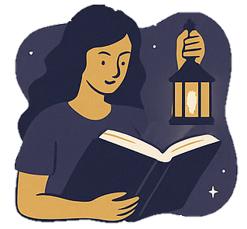
PROBLEM STATEMENT
No dedicated space for folklore, legends, mythology & short story enthusiasts.
Existing platforms are too text-heavy and overwhelming.
Lack of engaging UI/UX to attract younger, digital-native audiences.
Cultural stories risk becoming outdated and underexplored.

Slide 3

solution
LoreTrail: A digital storytelling platform focused on folklore, mythology & fantasy.
Visually engaging UI with interactive storytelling elements.
Community-driven space for writers & readers to share and explore stories.
Makes traditional tales accessible, attractive, and immersive for all ages

Slide 4
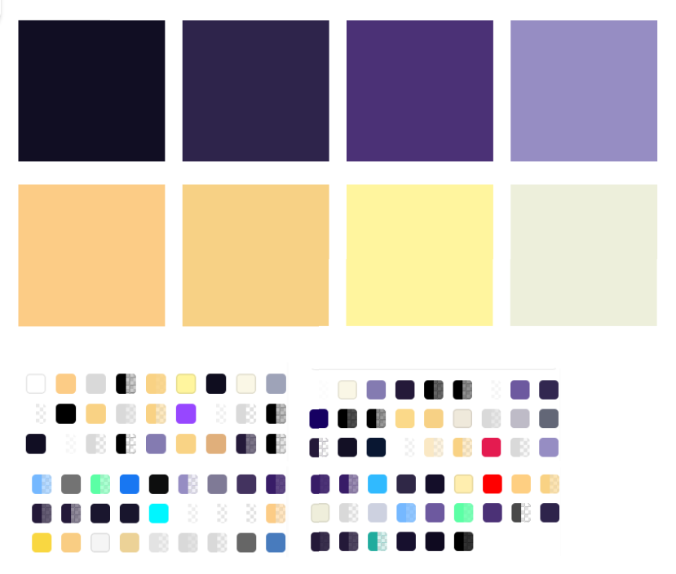
COLOR PALETTE
Shades of Purple form the primary base, symbolizing mystery, creativity, and the enchanting world of folklore and fantasy.
Gold Accents highlight key elements, adding richness and a magical, premium touch.
Off White and Gold Texts ensure readability while maintaining elegance and contrast.
Together, the palette creates a storybook-like atmosphere that feels immersive, engaging, and visually distinct from text-heavy platforms.

Slide 5
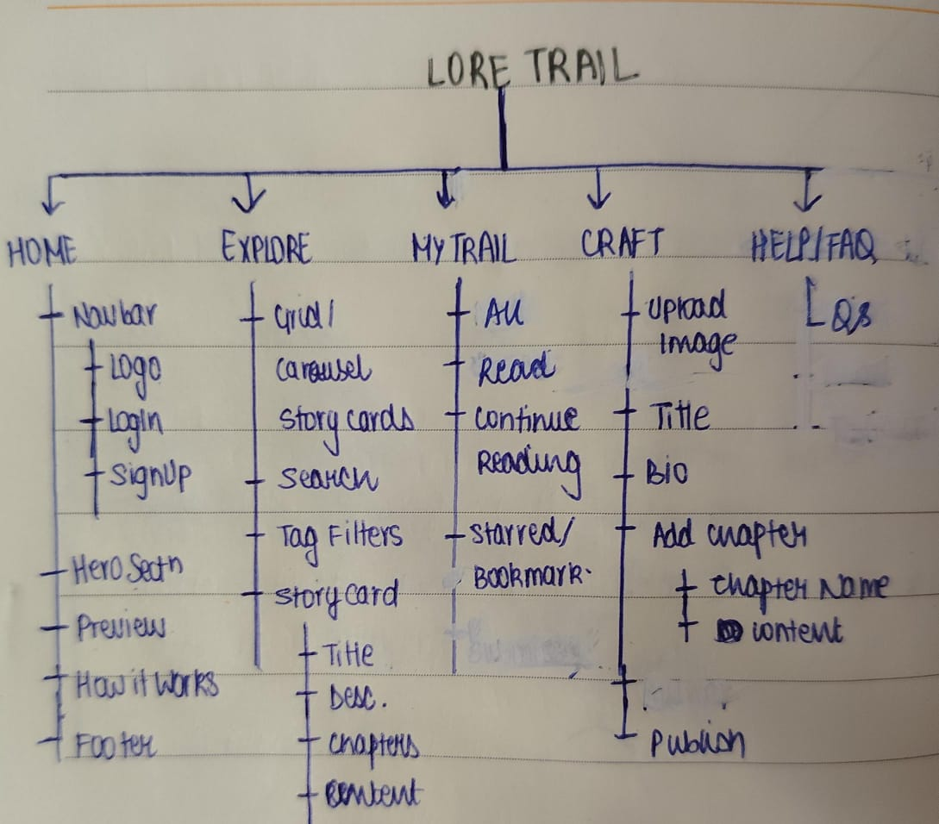
PAGE STRUCTURES
Home: Clear CTAs, featured stories, onboarding via How it Works/About Us.
Explore: From Pinterest-style → cleaner symmetric cards (user feedback).
My Trail: Personalized library (Continue Reading, Liked, All Reads) in consistent cards.
Craft Your Story: Simple writing space with Save Draft + Publish.
FAQ: Quick guidance to reduce confusion for first-time users.

Slide 6
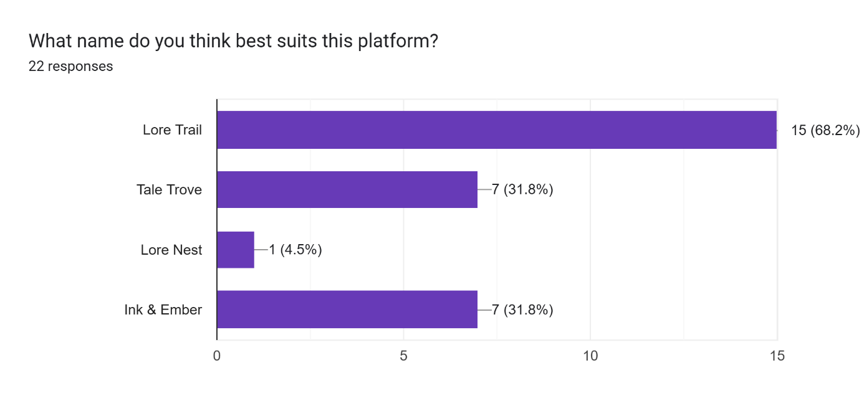
User Feedback Insights
Loved: Craft Your Story feature, My Trail library, mystical purple–gold look.
Clear & Intuitive: 77% found purpose clear; navigation rated smooth.
Needs Fix: Fonts readability, cleaner symmetric cards.
Wishes: More animations, & mobile-friendly design.
Takeaway: Validated LoreTrail’s appeal as a visual-first, engaging storytelling hub.

Slide 7
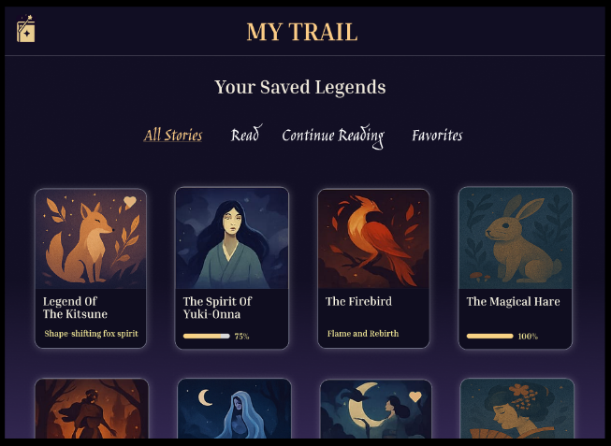
Visual engagement & impact
Shift from text-heavy structures → visual-first storytelling cards for better discoverability.
Card layouts: more engaging, scroll-friendly, and intuitive.
Symmetric card redesign based on user feedback → cleaner, more organized browsing.
Rich visuals + minimal text help reduce fatigue and keep users immersed in stories.
Result: Higher engagement, easier exploration, and stronger emotional connection.

Slide 8
Thank you
VAIBHAVI SRIVASTAVA @ Designora

